Slide 1
Tools for the real-time analysis
of disease outbreaks
Pierre Nouvellet
(and Simon Cauchemez)
MRC Centre for Outbreak Analysis and Modelling, DIDE
Imperial College London

Slide 2

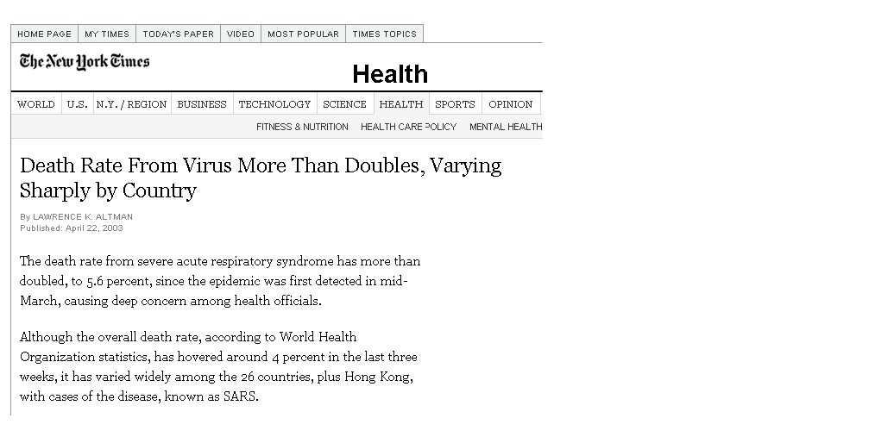
Real-time evaluation of a PH threat: What you do not want to be responsible of…
Statistical issues in real-time:
In real-time, naïve estimation of key quantities is biased;
We need to correct for these biases.
Emerging disease:
Lot of uncertainties – no/poor prior knowledge on the disease;
We need statistical methods that can correctly account for the high level of uncertainty;
We need methods that rest on as few assumptions as possible – robustness.

Slide 3
Overview: Real-time analysis of outbreaks
“Real-time” biases. Two types of biases:
Censored data – e.g. duration of hospitalization;
Truncated data – e.g. incubation period.
Estimating the case fatality ratio in an outbreak:
SARS – impact of the delay from symptom onset to death;
H1N1 pandemic influenza – selection bias: what if we just detect severe cases?
Assessing the efficacy of control measures during an outbreak:
Monitoring the effective reproduction number R in real-time;
R is underestimated in real-time;
How can we deal with uncertainty in model parameters?

Slide 4
Real-time biases
Censored data – truncated data

Slide 5
Censored duration of hospitalization
Cases who recovered or died
Cases who are still hospitalized
Time
1d
>3d
2d
>2d
The duration of hospitalization may be censored, i.e. we only know that it is larger than a given value
3d
>1d
>2d
2d
current time
Censored data are very common in biostatistics – survival analysis.

Slide 6
Survival probability
Survival probability at time t:
S(t)= probability that the duration D of hospitalisation is >t
S(t)= S(t-1) . Probability(D>t given D>t-1)
Survival probability
Time (days)

Slide 7
Kaplan Meier survival function
S(t)= S(t-1) . Probability(D>t given D>t-1)
Probability(D>t given D>t-1)
Probability(D>t)
t=0
S(0)=8/8=1
1d
Probability that D>1 given D>0:
7/8=87%
t=1
S(1)=1*0.87=0.87
>1d
2d
2d
Probability that D>2 given D>1:
4/6=67%
S(2)=0.87*0.67=0.58
t=2
>2d
>2d
3d
Probability that D>3 given D>2:
1/2=50%
>3d
S(3)=0.58*0.5=0.29
t=3

Slide 8
Kaplan Meier survival function
Survival probability
Time (days)

Slide 9
Truncated incubation period [Brookmeyer, Biostatistics, 2001]
t=0: Population exposed to anthrax
current time T=5 days
Time
1d
2d
Mean incubation period up to current time T
(1+2+2+3)/4=2 days
2d
3d
6d
Mean incubation period for the whole epidemic
(1+2+2+3+6+7+9)/7=4.3 days
7d
9d
We first observe cases with short incubation period;
When we naively estimate the incubation period in real-time, we under-estimate it!
Truncated data: we only observe incubation periods which are ≤5 days.

Slide 10
How to deal with truncated data?
Standard approach for data that are not truncated. For example:
Estimate the mean incubation period from dataset {d_{i}}
Define a statistical model. For example:
The incubation period d has an Exponential Distribution with mean m, density f(d|m), cumulative distribution function F(d|m).
Maximize the likelihood of the parameter m:
If the data is truncated:
Exactly the same approach, except that the likelihood is conditional on the duration being shorter than 5 if data are truncated after 5 days.

Slide 11
Estimating the case fatality ratio of an emerging infectious disease

Slide 12
Case fatality ratio
Proportion of cases who eventually die from the disease;
Often estimated by using aggregated numbers of cases and deaths at a single time point:
E.g.: case fatality ratios compiled daily by WHO during the SARS outbreak:
estimate of the case fatality ratio: number of deaths / total number of cases.
Simple estimates of these reports can be misleading if, at the time of the analysis, the outcome (death or recovery) is unknown for an important proportion of patients.

Slide 13
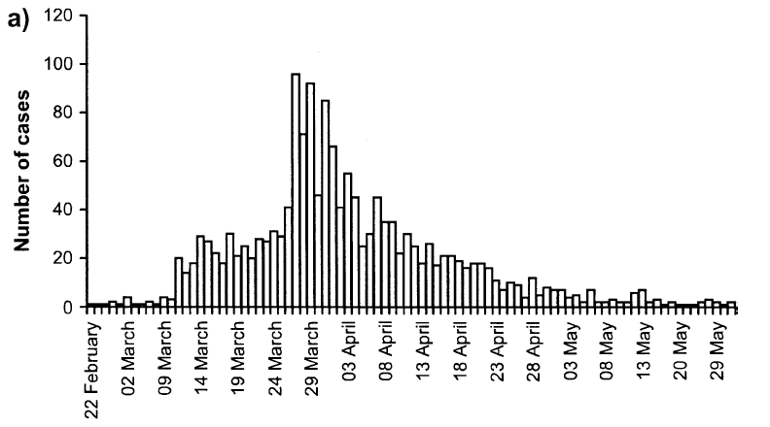
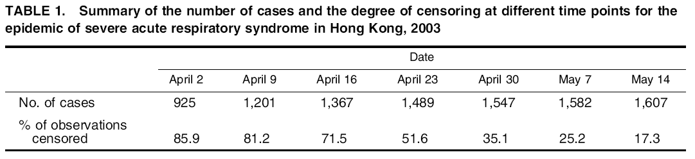
Proportion of observations censored in the SARS outbreak
We do not know the outcome (death or recovery) yet.
[Ghani et al, AJE, 2005]

Slide 14
Simple methods
Method 1:
Method 2:
D = Number of deaths
C = Total number of cases
D = Number of deaths
R = Number recovered

Slide 15
Adapted Kaplan-Meier method
To extrapolate incomplete survivor functions, assume that death/discharge rate at the tail occurs at the same rate as previously:
Proba death at the tail
Proba discharge at the tail

Slide 16
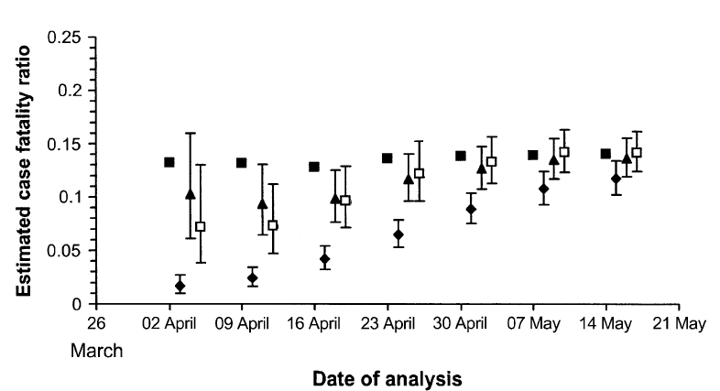

Comparison of the estimates
(nb. death / nb. Cases)
nb. death/(nb. death+recovered)

Slide 18
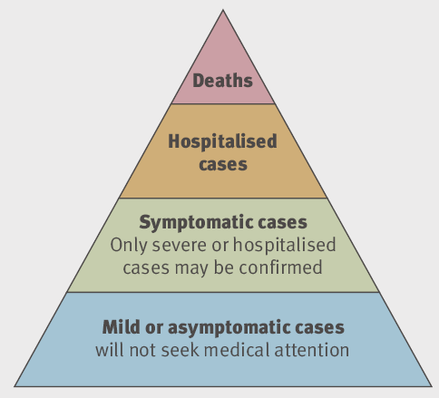
Dealing with the selection bias: Estimating CFR early on in the H1N1 influenza pandemic
May 5th 2009 in Mexico:
117 confirmed or suspected death;
12179 confirmed or suspected cases;
Naive estimate of case fatality ratio: 117/12179 ~ 1% (1918 pandemic ~ 2%)
But:
Under-reporting:
Only a proportion of cases are detected.
Case fatality ratio likely to be overestimated.
Method:
Rather than looking at surveillance data in Mexico, look at
International data on passenger flows from/to Mexico;
International data on confirmed and probable cases outside Mexico.
Back-calculate the total size of the Mexican outbreak.

Slide 19
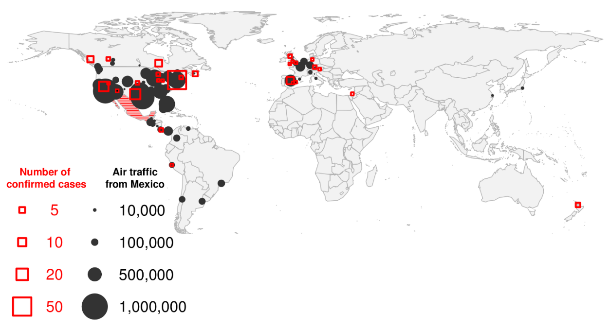
Global spread and the epidemic in Mexico
The number of passengers flying out of Mexico by actual destination and the number of
confirmed cases as reported on 30 April 2009. Fraser et al., Science, 2009

Slide 20
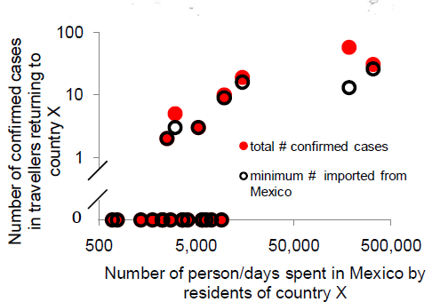
Correlation number of cases-number of travellers to/from Mexico

Slide 21
Backcalculating Mexico
Assumption: The daily rate λ at which people become infected while in Mexico is the same for locals and visitors.
Number of cases arising in country j due to infections in Mexico:
X_{j} ~ Poisson with mean = λ.t_{j}.n_{j}
t_{j} : the mean trip duration for people from country j,
n_{j} : the number of visits from country j during the outbreak.
Maximum Likelihood Estimation for λ
Expected number of cases in Mexico: λ.T.n_{M}
T : length of the outbreak in Mexico so far
n_{M} : size of Mexican population.

Slide 22
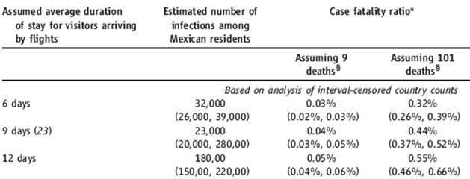
Results
21 deaths
0.091% (range: 0.066 to 0.35%)
Data available on April 30th 2009
[Fraser et al, Science, 2009]

Slide 23
Frailties of back-calculation
Assume random mixing of population in Mexico.
Assume visitors mix randomly with resident population.
Uncertainty about duration of visits.
Were all deaths ascertained?
Were all deaths attributed to H1N1 due to that virus?

Slide 24
Monitoring total number of cases in the UK (1)
Implications for planning
Paradoxically, once the pandemic really took off in the UK, it was harder to estimate the total number of cases.
Impossible to extrapolate from the number of people going to the GP for Influenza-Like-Illness.
Serology.

Slide 25
Monitoring total number of cases in the UK (2)
Observed nb of ILI visits
Scenario 1
Scenario 2
ILI visits support 2nd scenario but serology shows reality was closer to scenario 1.
Big changes in consultation rates between summer and autumn waves.
Highlights the limitations of sentinel surveillance.

Slide 26
Assessing the efficacy of control measures
Real-time monitoring of the reproduction number

Slide 27
Reproduction number R of an epidemic
Y=1
t=1
Y=2
t=2
Y=4
t=3
Y=8
t=4
Basic reproduction number R₀: number of secondary infections caused by one primary case in a completely susceptible population.
Effective reproduction number R_{t}: number of secondary infections caused by one primary case at time t.
Epidemic “under control” for R_{t}<1.

Slide 28
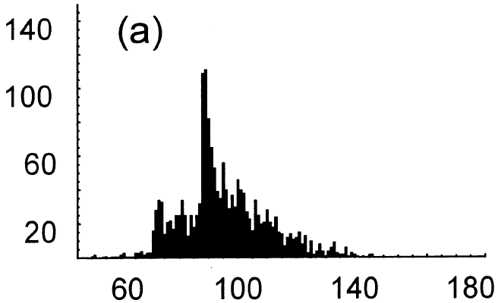
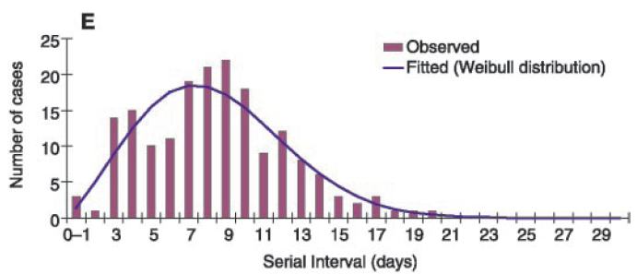
Monitoring R in an outbreak Inferring Who-Infected-Whom [Wallinga and Teunis, AJE, 2004]
Method used to estimate the trend of R during an outbreak;
Data:
Epidemic curve:
1…K cases have been observed;
Time of symptoms onset for case k: t_{k} (known).
Generation time:
Epidemic curve (SARS)
Nb. cases
Time (days)
Definition: time between symptoms onset of infector and symptoms onset of infectee;
The probabilistic distribution of the generation time is known: g(τ)
Nb. cases
Generation time (days)
[Lipsitch, Science,2003]
Reconstruct the whole transmission tree (who-infected-whom)

Slide 29
Toy example
Epidemic curve with 3 cases
t₁=0
t₂=1
t₃=2
Time
Case 1
Case 2
Case 3
p₁₂
p₁₃
Generation time distribution, g(τ)
What is R₁, number of cases infected by case 1?
Need to compute probabilities:
- p₁₂: case 1 infected case 2;
- p₁₃: case 1 infected case 3;
Expected value of R₁:
E(R₁)=p₁₂+p₁₃

Slide 30
What is the probability that case 3 was infected by case 1?
t₁=0
t₂=1
t₃=2
Time
Case 1
Case 2
Case 3
If case 1 infected case 3, proba for observed generation time is: 50%
Probability that case 3 was infected by case 1:
Case 1
Case 2
Case 3
If case 2 infected case 3, proba for observed generation time is: 20%
(General formula:

Slide 31
Example
t₁=0
t₂=1
t₃=2
Time
Case 1
Case 2
Case 3
p₁₂=1
p₁₃=0.71
Possible values for R₁: 0, 1, 2
R₁=0 if case 2 and case 3 are not infected by case 1:
probability (1-p₁₂).(1-p₁₃)=0.x0.29=0
R₁=1 if one of the 2 cases is infected by case 1:
probability p₁₂.(1-p₁₃)+ (1-p₁₂).p₁₃=1x0.29+0.x0.71=0.29
R₁=2 if the 2 cases are infected by case 1:
probability p₁₂.p₁₃=1x0.71=0.71
Mean value of R₁: E(R₁)=0x0+0.29x1+0.71x2=1.71
Variance of R₁: V(R₁)=0x(0-1.71)²+ 0.29x(1-1.71)²+ 0.71x(2-1.71)²=0.21

Slide 32
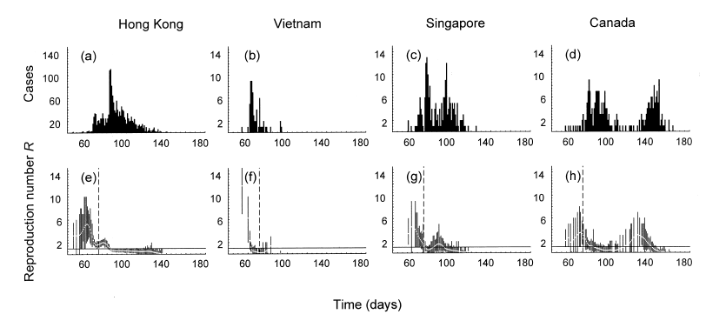
Retrospective analysis of the SARS outbreak [Wallinga and Teunis, AJE, 2004]
SARS 2003

Slide 33
Underestimation of R in real-time
current time T
There is 30% chance that a case generated by case 1 is not yet detected at time T.
If we naively estimate R₁ from data available up to time T, on average, we underestimate the reproduction number by 30%.
With data available up to time T, we have estimated that the expected number of secondary cases detected before T was:
E(R₁⁻)=1.71
But we also know that those detected cases only represent 70% of the total number of secondary cases:
E(R₁⁻)=0.7*E(R₁)
So, accounting for censorship, the corrected number of secondary cases (detected before T + not yet detected) is:
E(R₁)=E(R₁⁻)/0.7=1.71/0.7=2.44
t₁=0
t₂=1
t₃=2
Time
Case 1
Case 2
Case 3
?
Secondary cases detected before T (proba 0.2+0.5=0.7)
Secondary cases not yet detected - long generation time (proba 0.2+0.1=0.3)
R₁= R₁⁻ + R₁⁺

Slide 34
Bias and time lag δ=Τ−t₁
Time lag δ=Τ−t₁
current time T
t₁=0
Bias
Average (estimator - true value)/true value
Case 1
SARS-like outbreak;
Generation time:
Mean: 8.4 days;
Standard deviation: 3.8 days;

Slide 35
SARS Hong Kong outbreak: real-time estimates of R
Early estimates are unbiased but may have large variance
Uncertainty is larger during periods of low incidence

Slide 36
Summary so far…
In real-time, we under-estimate the reproduction number R because secondary cases with long generation time may be undetected:
Risk to be too optimistic!
We can correct for this bias:
Unbiased estimator available;
But, if we try to estimate R very early, the estimator may have a large variance:
t₁
current time T
Time
Case 1
Situation where estimates may have large variance: most of the secondary cases (80%) are not yet detected

Slide 37
Uncertainty in model parameters

Slide 38
Uncertainty in model parameters
So far, we have assumed that the distribution g(τ|μ,σ) of the generation time was known:
50%
Characterized by:
Mean: μ=2.2 days;
Standard deviation: σ=0.9 days.
No uncertainty.
20%
For this specific characterization of the generation time, we obtained 1 estimate for R
Slightly different characterization of the generation time, different estimate of R:
Case 1
Case 2
Case 3
Time
T
40%
30%

Slide 39
Emerging infectious disease: no prior knowledge on the generation time
current time T
Data collected during the epidemic:
Symptom onset:
Case tracing:
t1
t2
t3
t4
t5
t6
t7
Time
1
2
4
6
4
7
Generation time:
At first, the generation time is unknown;
First estimates of the mean and variance of GT have a large variance;
During the course of the epidemic, estimates become more precise.
How can model predictions correctly account for uncertainty in model parameters?

Slide 40
Frequentist statistics – Bayesian statistics
Contact tracing data:
Observed values for the generation time: 1, 1, 2, 2, 2, 3, 3 and 4 days.
What is the mean generation time μ?
Frequentist statistics: Point estimate: 2.25 days ; 95% Confidence Interval 1.53, 2.97 days.
Bayesian statistics:
We have a prior belief on the parameter μ: e.g. the mean generation time is uniformly distributed between 0-15 days (NB: may be very vague; e.g. uniform in 0-10,000 days).
We see how our prior belief is modified by the dataset: the posterior distribution.
Bayes formula:
Posterior distribution
P(μ|data)
Prior belief P(μ)
Data: observed values for the generation time are 1, 1, 2, 2, 2, 3, 3 and 4 days
Probability
Probability
Mean generation time (days)
Mean generation time (days)

Slide 41
Bayesian statistics: Deriving the posterior distribution
Markov chain Monte Carlo (MCMC) algorithm:
Generic algorithm to determine the posterior distribution (can be used to deal with very complex inferential problems);
Output of the MCMC algorithm: a large sample of values for the parameter, drawn from the posterior distribution.
E.g.: possible output of the MCMC for the mean generation time μ:
2.2, 2.3, 2.2, 2.5, 2.2, 2.1, 2.2, 2.3, 2.2, 2.1 (size of the sample: 10)
Values which appear a lot in the sample are the most probable:
P(μ=2.2|data) = (nb. of times where value=2.2)/size of the sample
= 5/10 =50%
Values which are rare in the sample are the less probable:
P(μ=2.5|data) = 1/10=10%

Slide 42
Bayesian statistics: Unifying inference & prediction
Contact tracing data - observed values for the generation time: 1,1,2,2,2,3,3,4 days
Prior belief
Bayesian statistics (MCMC)
Posterior distribution for the mean and variance of the generation time:
μ=2.2 days, σ=0.9 days
μ=2.3 days, σ=0.8 days
μ=2.2 days, σ=0.9 days
μ=2.5 days, σ=0.7 days
μ=2.2 days, σ=0.9 days
μ=2.1 days, σ=1.0 days
μ=2.2 days, σ=0.9 days
μ=2.3 days, σ=0.8 days
μ=2.2 days, σ=0.9 days
μ=2.1 days, σ=1.0 days
Reproduction number
R₁=2.44
R₁=2.78
R₁=2.44
R₁=3.30
R₁=2.44
R₁=2.00
R₁=2.44
R₁=2.78
R₁=2.44
R₁=2.00
Model prediction using generation time+epidemic curve
Uncertainty in model input
Uncertainty in model output
P(R₁=2.44|data)=5/10=50%
Posterior mean:
(5*2.44+2*2.78+3.30+2*2.00)/10=2.51

Slide 43
Monitoring an outbreak
SARS-like outbreak:
GI interval: mean 8.4 days and SD 3.8 days;
Reproduction number:
R=3 before control measures;
R=0.7 after control measures;
5% of the cases are traced.
Simulated epidemic:
2086 cases;
114 traced cases.

Slide 44
Distribution of the generation interval in real-time
Mean (a) and standard deviation (b) of the generation interval (GI).

Slide 45
Reproduction number for the last 10 days of follow-up
At time t: estimate of R
for time period [t-10, t]
with data available up to time t

Slide 46
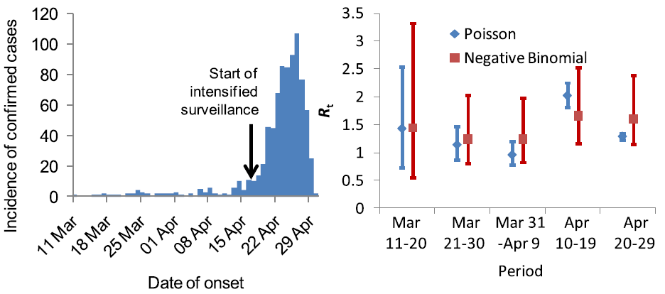
Similar approaches used during the H1N1pdm outbreak in Mexico
- Poisson: R0=1.4 [1.2,1.6]
- Neg Bin: R0= 1.5 [1.2,1.9]
[Fraser et al, Science, 2009]

Slide 47
Summary
In real-time, key epidemiological quantities are biased:
We do not observe cases with long incubation period or generation times (truncated data);
Other key quantities (duration of hospitalization, reproduction number…) are censored, e.g. , a case is hospitalized for at least yy days (but we do not know how many days exactly);
For the case fatality ratio:
the outcome (death or recovery) may be unknown for a large proportion of the cases;
there may be a selection bias (difficult to deal with in general).
In real-time, a lot of uncertainty in input parameters:
Simple & robust methods;
Bayesian statistics provide a natural setting to unify tools for inference and tools for prediction.

